Slide 1
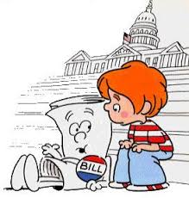
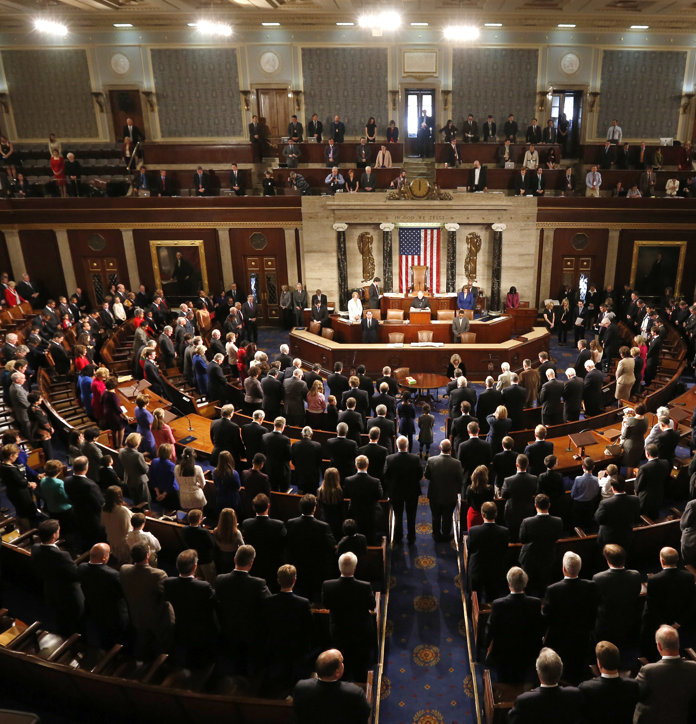
Senate BEAT
Notes:
Our objective was to create resources to better understand how congress works, and how they spend their time. While congress.gov allows you to examine bills individually, very few resources exist for the public to visualize trends overall.
https://www.youtube.com/watch?v=4daJ8gMtE-g <- pulling sound bite at minute 70 (patriotic music

Slide 2
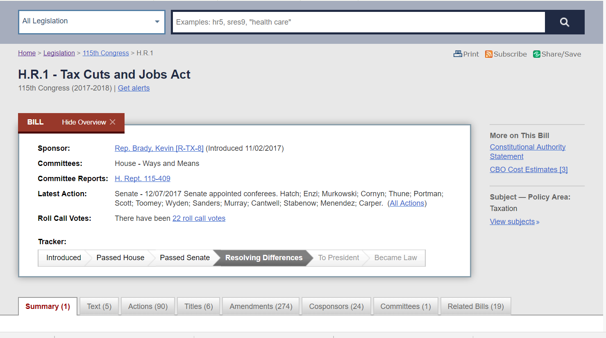

Slide 3


Slide 4
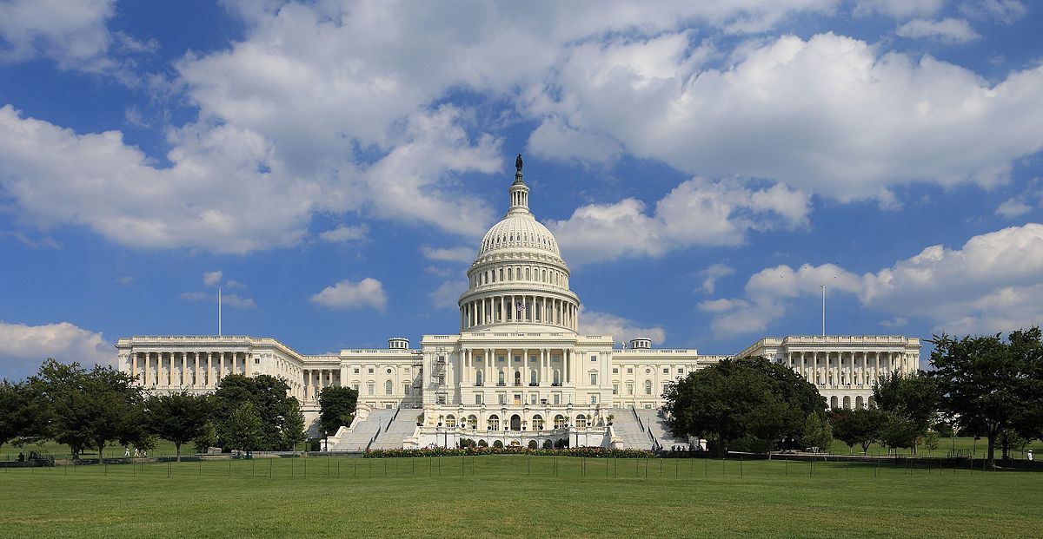
Senate BEAT
(Bill Exploratory Analysis and Tracking)
Notes:
Given the public's distaste for the way media frames political discussions, it is becoming more important for individuals to understand the process and be given raw information to draw their own conclusions.
This led to the creation of Senate BEAT – Bill Exploratory Analysis and Tracking

Slide 5

Data Scraping:
Bulk download from 113th and 114th session via congress.gov (thanks government transparency!)
Scraped data from 115th session (currently happening)
Tools:
Data Visualization
Summary statistics
Network science
Model building
Rshiny and flexdashboard
Notes:
We obtained data from the 3 most recent sessions and determined 6 major bill outcome classifications. We used a variety of tools –listed here– to help us answer our questions.

Slide 6
Major Questions:
What is the prevalence of bill topic, by: legislative session, legislator, state?
What is the probability that a certain bill topic be voted on, or become a law?
How does geography and region affect policy area and legislative subject focus areas?
How many bills do states generally sponsor each session?
Which legislators have similar interests? Which legislators work with each other, and cosponsor bills together?
Notes:
We examined major factors that could determine a bill's success, evaluated the congressional network, and looked at trends. We wanted to create clear, visuals so the public can explore certain party, state, or senator activity.

Slide 7
Now will go to Senator Beat page and screencast
Click through storyboard – works best on Chrome
Notes:
This video provides an overview, [click] yet please go through the storyboard [click] to learn about some interesting findings [click], and better understand how the tools work![click] (click thorugh the storboard while talking)

Slide 8
Now will go to Senator Beat page and screencast
Bill modeling and exploration - chrome
Notes:
Users can explore different aspects of the bill process. (clikc while talking) the word cloud allows you to see the legislative area topics, per party.
Using lasso regression, we were able to model the probability that a certain bill becomes a law, which can be further filtered by session, and viewed by state or subject

Slide 9
State Level Policy Interests
Bill modeling and exploration - chrome
Notes:
(hover while talking) Hover over the map on this page to see the number of bills each state submitted – (filter while talking)
Notice the stark geographic contrast between the East and West for number of Public Lands and Natural Resources bills that are sponsored

Slide 10
Senator Activity
Notes:
(however while talking) Get up-close with the senators!. In the 114th, David Vitter sponsored 125 bills (more than any other Senator) and only 2 passed– despite his rather dense network degree. (select 113^{th)} In the113th, he had a 0% success rate.

Slide 11
Senate Overview
Notes:
Select a senator, session, party, and # of subjects to see top legislative subjects a senator supports, and the senators that most closely align with their interests

Slide 12

Senate BEAT
Notes:
There is much more you can see on this site, and we hope it can help you become more informed about the work happening in Congress – enjoy exploring!
https://www.youtube.com/watch?v=4daJ8gMtE-g <- closing with the same patriotic music from slide 1 (miunte 70)

